Slide 1
Capstone Engagement
Assessment, Analysis, and Hardening of a Vulnerable System
Madeleine Simpson 2021

Slide 2
Table of Contents
This document contains the following sections:
01
Network Topology
02
Red Team: Security Assessment
03
Blue Team: Log Analysis and Attack Characterization
Hardening: Proposed Alarms and Mitigation Strategies
04

Slide 3
Network Topology
‹#›

Slide 4
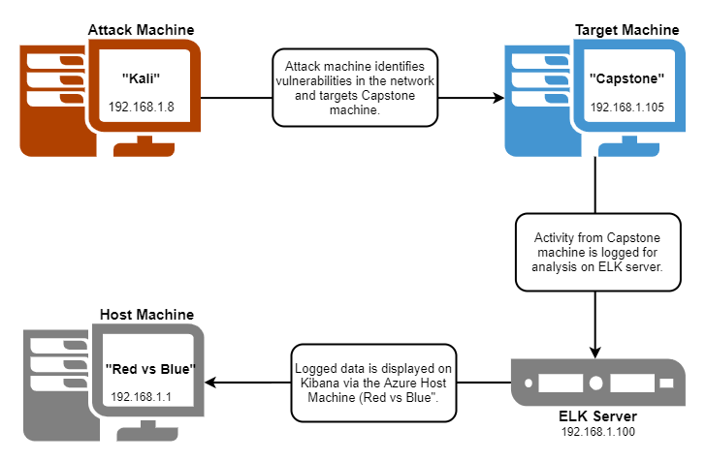
Network Topology
[Insert Here]
Use draw.io to create a diagram of the network.
Add your diagram to this slide and fill out the data in the sidebar.
Network
Address Range: 192.168.1.0
Netmask:
Gateway: 192.168.1.1
Machines
IPv4: 192.168.1.8
OS: Linux 3.7 - 3.10
Hostname: Kali
IPv4: 192.168.1.105
OS: Linux 3.2 - 4.9
Hostname: Capstone
IPv4: 192.168.1.100
OS: Linux 3.2 - 4.9
Hostname: ELK
IPv4:192.168.1.1
OS: Windows XP
Hostname: Red vs Blue - ML-REFVM

Slide 5

Red Team
Security Assessment
‹#›

Slide 6
Recon: Describing the Target
Nmap identified the following hosts on the network:
Hostname | IP Address | Role on Network
Red vs Blue | 192.168.1.1 | Virtual Host Machine
Kali | 192.168.1.8 | Attack Machine
ELK | 192.168.1.100 | Network Monitoring machine logging activity with Kibana
Capstone | 192.168.1.105 | Target Machine

Slide 7
Vulnerability Assessment
The assessment uncovered the following critical vulnerabilities in the target:
Vulnerability | Description | Impact
Port 80 Open | Unsecured access open to public entry via Port 80 on web browser. | Allows attackers to locate and access private directory with accessible files.
Sensitive Data Exposure | Unprotected, cleartext storage of credentials and sensitive information accessible to public. Ie. usernames (Ryan, Ashton etc) and direct reference to hidden directories (secret_folder). | Gives attackers starting points for potential usernames and other useful information to aid in exploitation of the system/data.
Simplistic usernames | Employee’s first names used as usernames are quickly and easily discoverable. | Attackers are able to create wordlists of potential usernames using employee names in order to brute force entry.

Slide 8
Vulnerability Assessment
The assessment uncovered the following critical vulnerabilities in the target:
Vulnerability | Description | Impact
Brute force vulnerable passwords | Use of weak passwords (short, simple words, names, common strings of numbers such as birthdays/years, no symbols etc) | System access through brute force with simplistic passwords included in common password lists such as rockyou.txt, utilised by password cracking programs such as ‘John the ripper’, ‘Hydra’ and more.
Hashed (and unsalted) Passwords | Unsalted hashed passwords can be easily cracked using programs (hashcat) or online tools (crackstation.net.) | Cracked passwords combined with known usernames can allow an attacker access to system files.
WebDav Vulnerability | WebDav enabled with unrestricted upload of malicious files possible. | Attackers able to create a shell in the target system using a reverse shell and meterpreter.

Slide 9
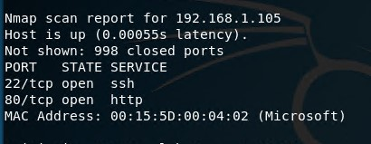
Exploitation : Open Port 80
01
Tools & Processes
Nmap was used to scan for open ports and services within the network.
02
Achievements
Nmap identified IP address 192.168.1.105 had an open port 80.
From here access was gained to a directory via web browser containing company files and information.

Slide 10
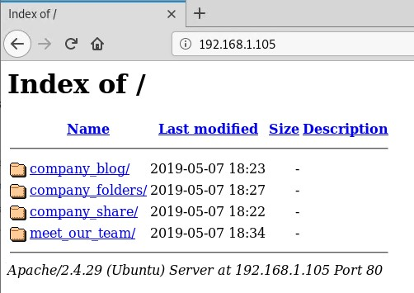
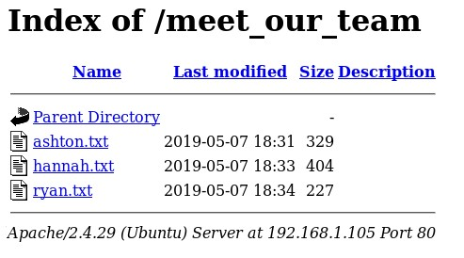
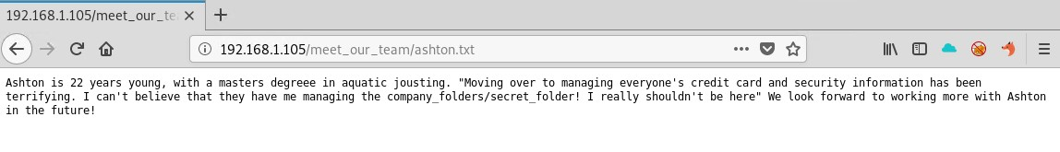
Exploitation: Accessible Files
01
02
Tools & Processes
Within the directory accessed through port 80, a number of company folders and files were able to be viewed.
Achievements
Intel was identified which suggested a potential means of access to the system. That being, the existence of a “secret” folder and it’s location, as well as it’s likely associated username.

Slide 11
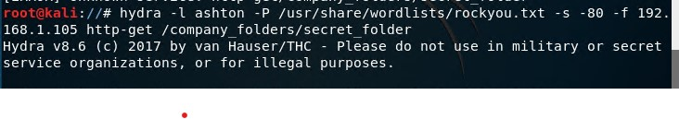
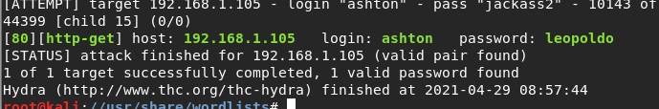
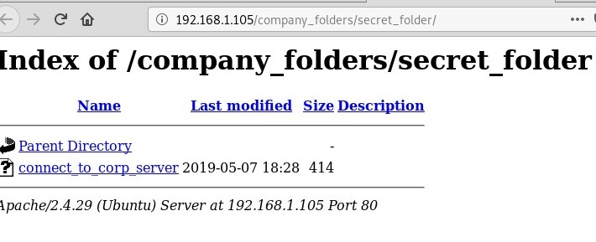
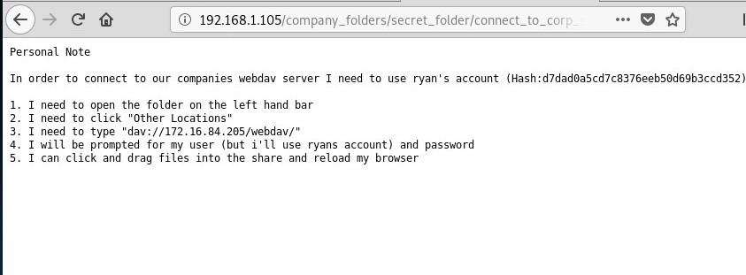
Exploitation: Brute Force Password
01
Tools & Processes
The Hydra tool was utilised in order to brute force Ashton’s password, in conjunction with the rockyou.txt file.
02
Achievements
The exploit provided ashton’s password and confirmed username, facilitating access to the secret folder.

Slide 12
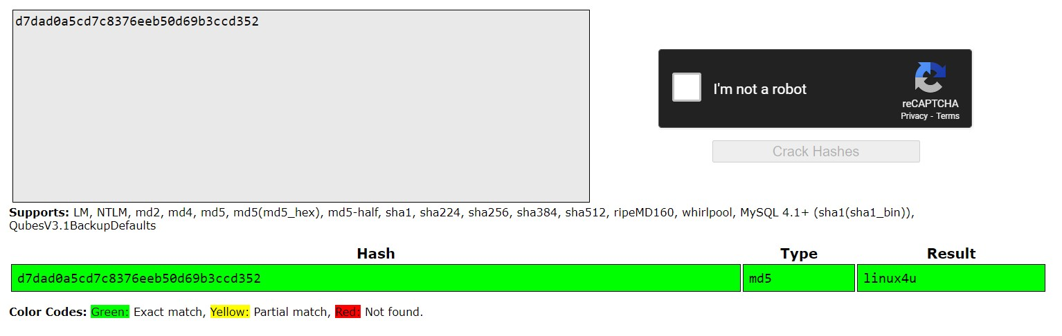
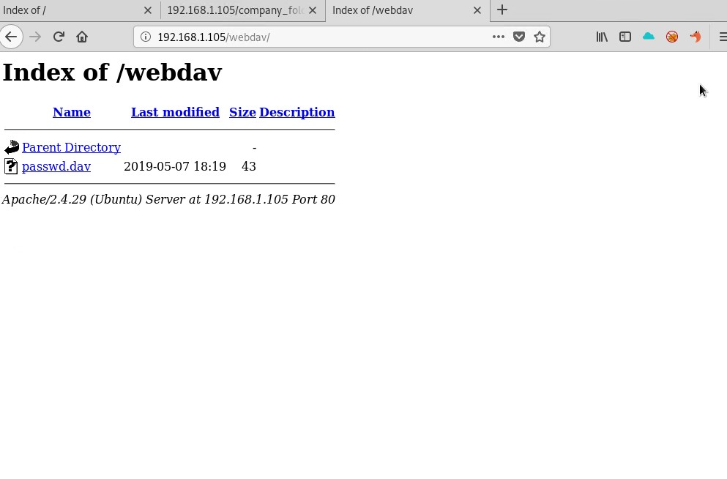
Exploitation: Hashed Password
01
Tools & Processes
The Hydra tool was utilised in order to brute force Ashton’s password, in conjunction with the rockyou.txt file.
02
Achievements
The exploit provided ashton’s password and confirmed username, facilitating access to the secret folder.

Slide 13
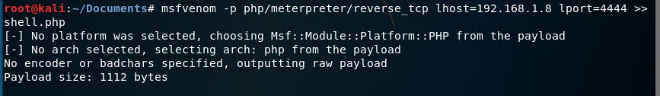
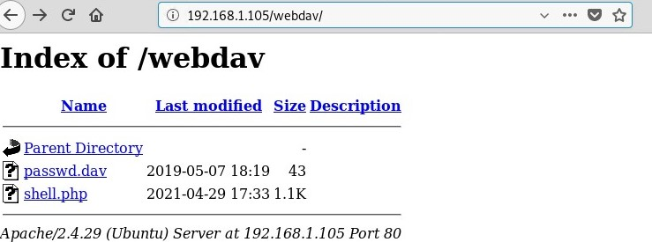
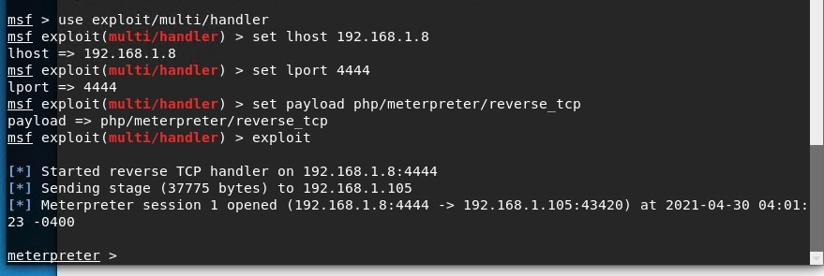
Exploitation: WebDAV
01
Tools & Processes
I used msfvenom and meterpreter to generate and deliver a reverse tcp payload to the capstone machine via the WebDav connection.
02
Achievements
Using the multi/handler exploit I gained access to the machine’s shell, commencing a meterpreter session.

Slide 14

Blue Team
Log Analysis and Attack Characterization
‹#›

Slide 15
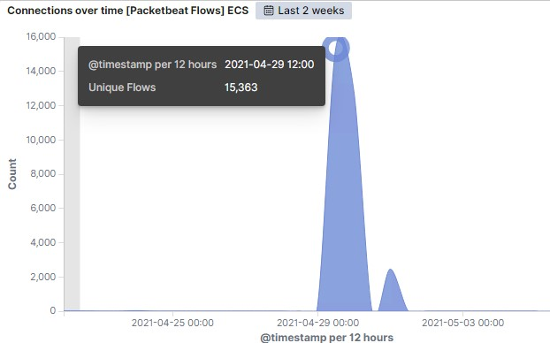
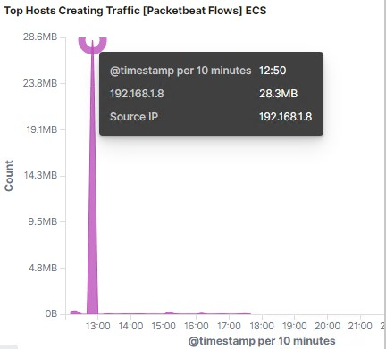
Analysis: Identifying the Port Scan
Port scan occurred on 29/4/2021 at 1200.
15,363 packets were sent from IP 192.168.1.8
The significant peak in network traffic indicate a port scan occurred.

Slide 16
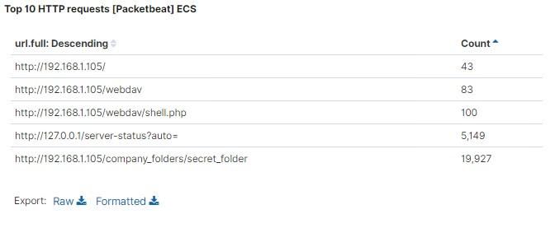
Analysis: Finding the Request for the Hidden Directory
The requests started at approximately 12:30 on 29/04/2021.
A total of 19,927 requests were made to access the /secret_folder.
The directory in question contained instructions to connect to the company’s webDAV server as well as a hashed password for another employee’s (Ryan) login to said server.

Slide 17
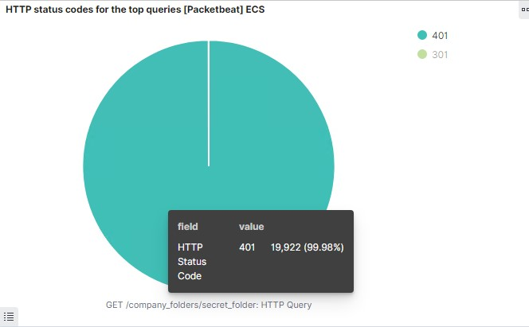
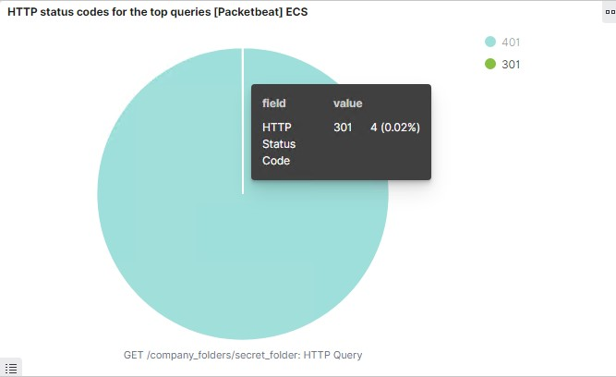
Analysis: Uncovering the Brute Force Attack
19,922 requests were made in the brute force attack.
Of those, 4 requests were successful (returning a 301 HTTP status code.)

Slide 18
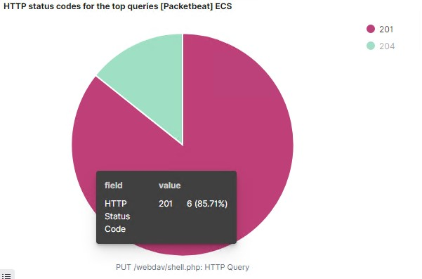
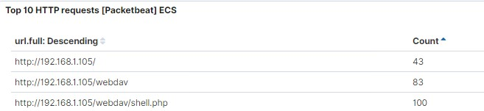
Analysis: Finding the WebDAV Connection
83 requests were made to the/webdav directory.
The primary requests were for the shell.php file (which received 100 requests).
6 HTTP PUT requests to webdav/shell.php returned a 201 status code, indicating the successful creation of a file.

Slide 19
Blue Team
Proposed Alarms and Mitigation Strategies
‹#›

Slide 20
Mitigation: Blocking the Port Scan
Low-level alert for any port scanning, with a threshold of more than 10 scans in a minute.
Severe alert for 100+ consecutive ping (ICMP) requests.
Whitelist known IPs and only allow required traffic to access internal hosts, denying all other IPs from scanning.
Establish regular system port scan to detect and audit open ports and close ports that need not be open.
Use iptables to drop packet traffic when thresholds are exceeded.

Slide 21
Mitigation: Finding the Request for the Hidden Directory
Remove all references to hidden directory and limit user access to root directory.
If possible remove hidden file from server all together.
Rename folders containing sensitive company data.
Encrypt all sensitive data contained within private folders/files.
Whitelist IP addresses that require access to these directories to not trigger alerts.
Set an alert for any requests to hidden directory/ies.
Set threshold of 1 attempt by an unrecognised IP to trigger alert.

Slide 22
Mitigation: Preventing Brute Force Attacks
For all password portals (webserver and SSH) set up alerts for ‘401 unauthorised’ returns:
Low-level alert for 3 consecutive login failures due to incorrect password.
Severe-alert for 20 consecutive login failures.
Set a system lockout for 30 minutes after 3 consecutive password failures.
Set timeout for 1 hour after 5 further failures.
Blacklist IP after 10 failed attempts.
Set password strength requirements (ie. minimum length of 8 characters, upper and lowercase letters, numbers and symbols required.
Establish recurring password reset every 3 months.
Establish multi-factor authentication for accounts with high privileges.

Slide 23
Mitigation: Detecting the WebDAV Connection
Set alarm on all HTTP GET requests from non whitelisted IP’s attempting to access webDAV directory.
Set alarm on all HTTP PUT requests made.
Establish whitelist of trusted IP addresses and ensure firewall blocks access to all others.
Only allow internal access to WebDAV within companies network. Deny external connection attempts.

Slide 24
Mitigation: Identifying Reverse Shell Uploads
Set alert for any traffic moving through port 4444.
Set alert for anything which triggers anti-virus/anti-malware software, or any files containing suspicious code/file extensions.
Threshold of 1 attempt.
Utilise anti-virus/anti-malware software to screen all incoming files.
Restrict upload of .php files.

